Slide 1
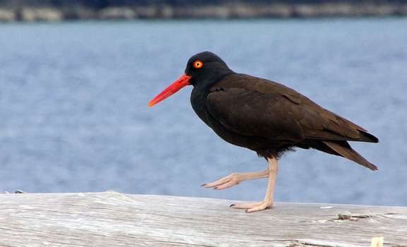
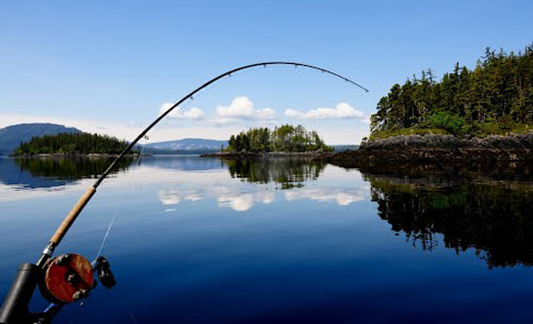
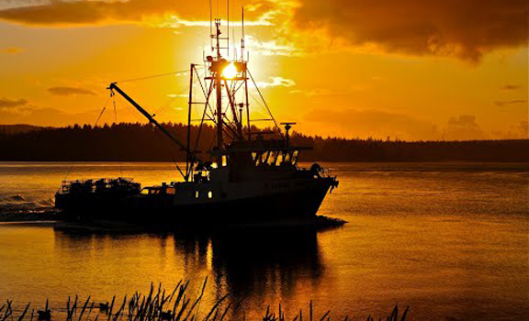
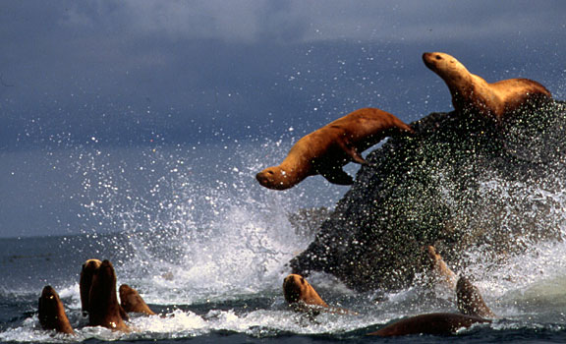
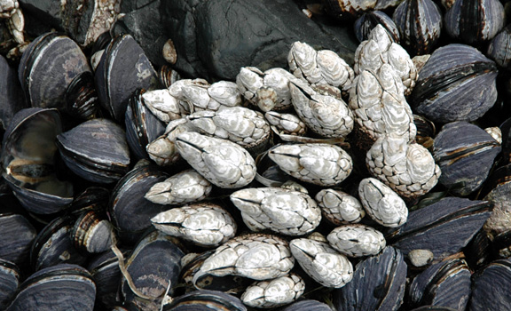
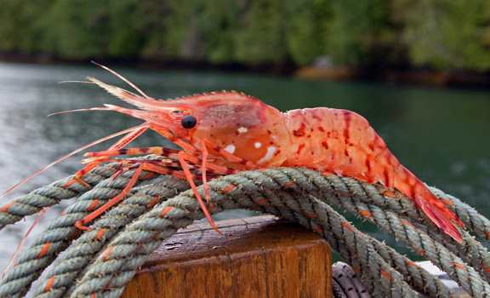
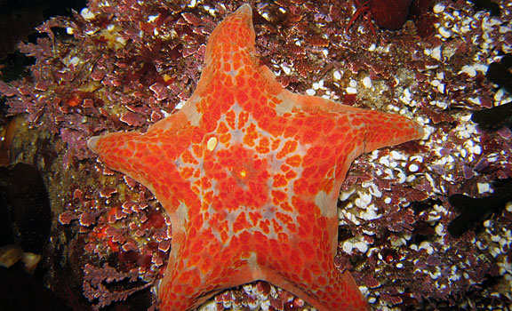
Marine Planning in British Columbia
Charlie Short – Manager, Marine Initiatives
Ministry of Forests, Lands and Natural Resource Operations

Slide 2
Presentation Overview
Overview of jurisdiction and roles of responsible governments
What role does the province play in marine planning
Marine Planning Partnership for the North Pacific Coast (MaPP)
Other Marine Planning Initiatives – lay of the land

Slide 3
What is the Province’s Jurisdiction in the Marine
Environment?
Most modern day marine planning initiatives require multi-party MoUs, collaborative governance models and are supported by multi-partner funding agreements.
Province has legislative jurisdiction over public ‘crown’ coastal lands, inland waters and seabed lying “between the jaws of the land” (“intra fauces terrae”) (i.e., bays, estuaries, inlets, fjords, channels, sounds)
Federal government has legislative jurisdiction over resources in the water column (e.g., fish) and regulates activities on the ocean surface (e.g., shipping)
Local governments also influence management in the coastal zone through by-laws & local government plans.
First Nations also have rights & title in the coastal zone & marine waters, use coastal & marine areas for cultural and spiritual purposes, and have developed coastal plans in traditional territories.
Note: This is not a legal interpretation, nor a position statement of the Province of British Columbia; nor does it address First Nations’ rights and title.

Slide 4
Provincial authorizations in the coastal zone
Tenured Uses
Shellfish Beach Aquaculture
Shellfish Deepwater Aquaculture
Marine Plant Aquaculture
Finfish Aquaculture
Marine Residential
Floating Lodges & Camps
Boat Launches
Commercial Recreation Guiding
Log Booming Grounds
Log Handling Facilities
Helicopter Log Drops
Commercial Uses
Tenured Uses (cont’d)
Private Residential Moorage
Light Docks, Wharves & Facilities
Heavy Docks, Wharves & Facilities
Marine Telecommunications & Utilities
Conservation (i.e., MPAs)
Non Tenured Activities
First Nations Uses
Commercial Fisheries
Public Recreation
Marine Transportation

Slide 5
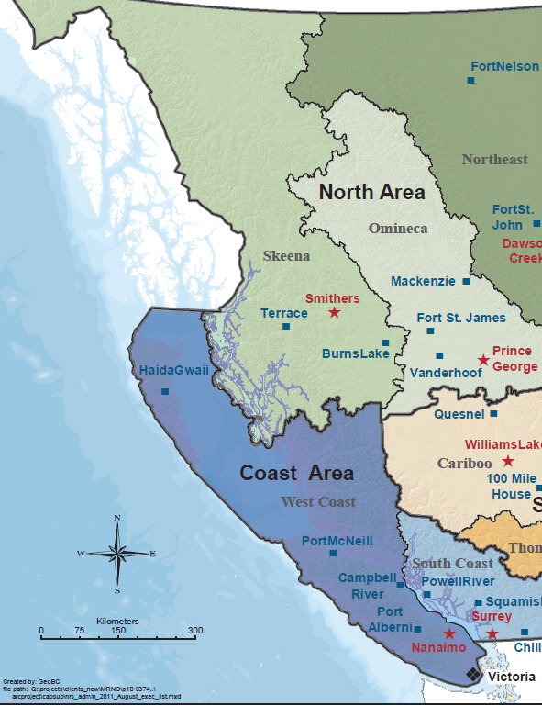
Natural Resources Sector Administrative Boundaries
NRS Boundaries
Skeena Region
West Coast Region
South Coast Region
Generally reflect “jaws of land” and extend ~ 5km (3nm) seaward on outer coast.

Slide 6
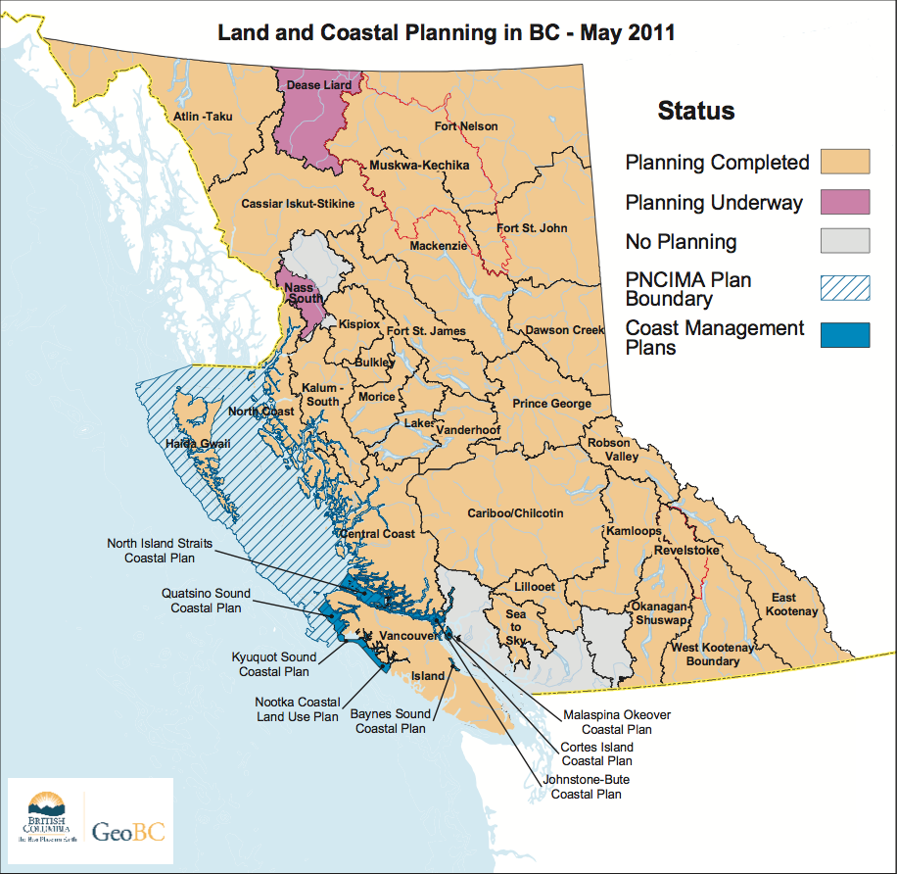
Marine Planning in British
Columbia

Slide 7

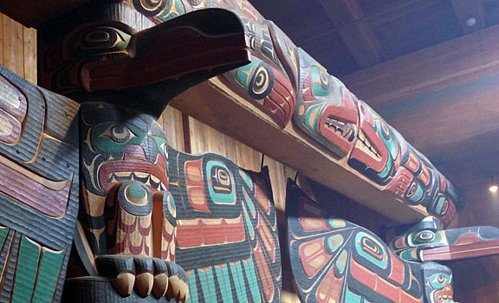
What is the Marine
Planning Partnership?
The Marine Planning Partnership for the Pacific North Coast (MaPP) is a
collaboration between:
  Province of B.C., as represented by the Ministry of Forests, Lands and Natural Resource Operations
  Coastal First Nations – Great Bear Initiative
  North Coast-Skeena First Nations Stewardship Society
  Nanwakolas Council
These First Nations entities represent 20 individual First Nations
Letter of Intent (LOI):
  Signed in November, 2011
  Agreement on the structure of the MaPP initiative and outlining key planning deliverables
  Memorandum of Understanding (MoU) for a Marine Planning Partnership Support Fund - supplements the existing resources of the parties.

Slide 8
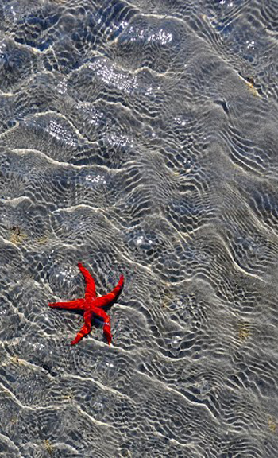
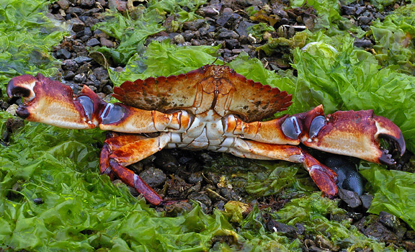
MaPP Intended Results
The intent of the MaPP initiative is to create
four coastal and marine plans, accompanied
by Implementation agreements, in four sub-regions
the North Coast, the Central Coast,
North Vancouver Island and Haida Gwaii, by December 2013.
Partner First Nations and the Province of B.C. share planning
priorities including:
Collaboration between governments
An Ecosystem-based Management approach that strives to balance ecological and human needs including:
    Integrated Economic Strategies
    Marine Protected Areas (MPAs)
    Climate Change
    Cumulative Effects
Marine Spatial Plans
MaPP will bring together the best available science, traditional knowledge and input from robust public and stakeholder engagement.

Slide 9
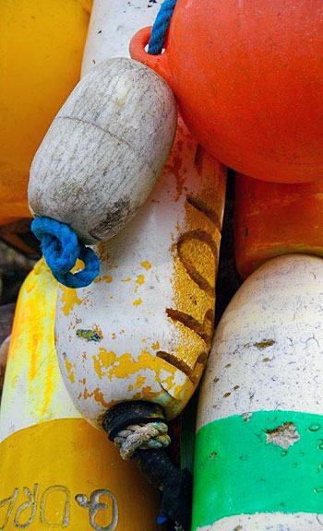
Where are we now with MaPP?
Budget, work plan and scope planning work defined;
Staff hired;
ToRs for governance committees and technical groups;
ToR for Stakeholder Committees; including a schedule for meetings;
Science Advisory Committee established with ToR
Advisory committee meetings start late May early June

Slide 10
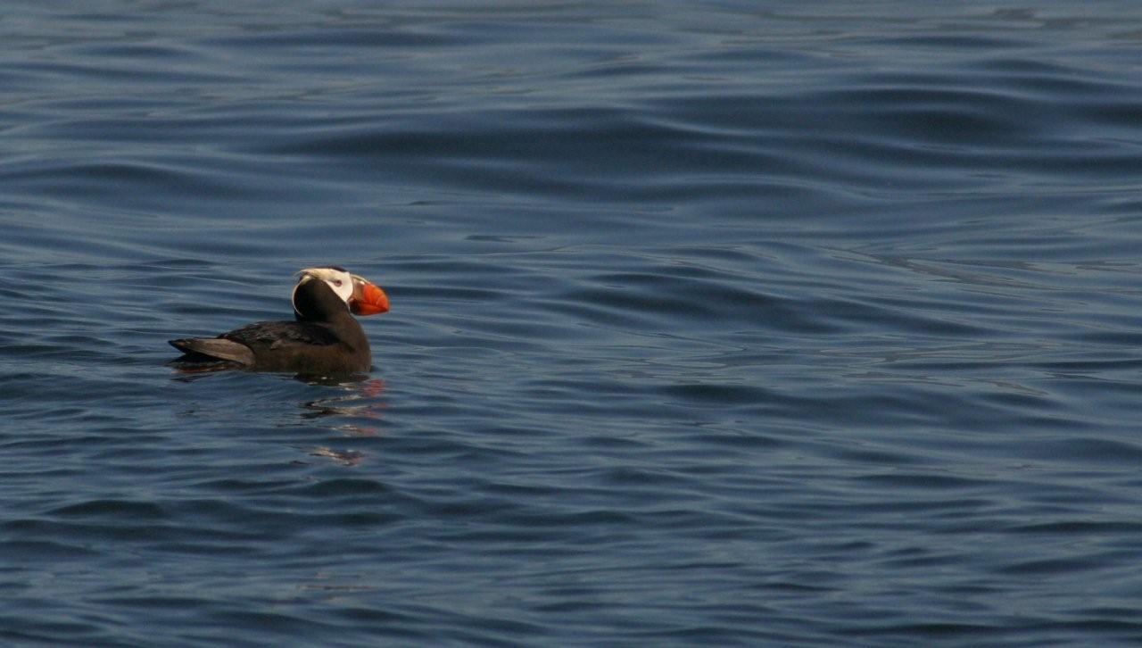
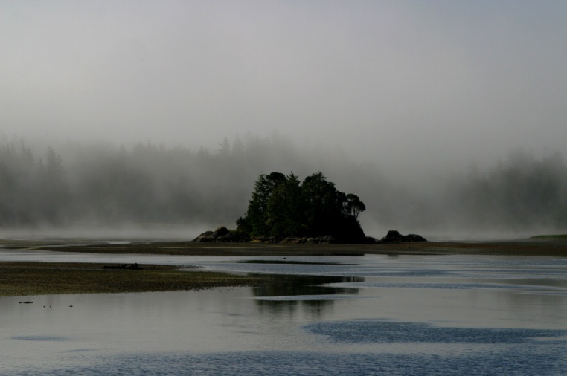
The Pacific North Coast Integrated Management (PNCIMA)
A strategic planning initiative in a partnership between DFO, FN and the Province of BC. Same planning area as MaPP. Completion date – December 2012
Key outputs are:
  An EBM framework – goals, objectives, strategies
  Priority marine values – ecological, social, economic, cultural
  Risk Assessment for identified values
West Coast Aquatics (WCA)
A planning initiative on the west coast of Vancouver Island. Directed by a board consisting of the province, DFO, local government, stakeholders and First Nations. Completion date – 2012-2013
Key outputs are:
Strategic plan for west coast Vancouver Island
Marine Spatial Plans for Clayoquot Sound and Barkley Sound.

Slide 11
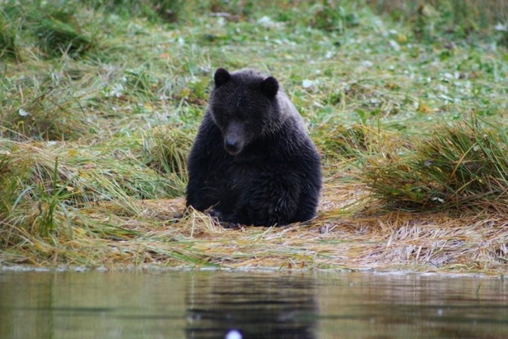
Marine Protected Area (MPA) Planning
A Canada-British Columbia Marine Protected Network Strategy has been drafted for British Columbia in collaboration with federal agencies. The strategy outlines a vision, goals and specific design principles
for a BC network of MPAs.
Race Rocks Ocean’s Act MPA—This is a proposed MPA by the Department of Fisheries and Oceans (DFO) as an area of interest. Consultations with public, First Nations, and stakeholders are ongoing. The area is currently a provincial ecological reserve.
Southern Strait of Georgia National Marine Conservation Area—The Provincial/Federal working group is nearing completion of a feasibility assessment for a National Marine Conservation Area in
the Southern Strait of Georgia. Current focus is communication and consultation with
First Nations.
Sponge Reefs Ocean’s Act MPA—This is a proposed MPA by the Department of Fisheries and Oceans (DFO) as an ‘area of interest’. Location is Hecate Strait.
Marine Conservancy Boundaries— Consultation is ongoing with Coastal First Nations regarding Central/North
Coast LRMP and Haida Gwaii SLUA conservancy marine boundaries recommendations.
Scott Island National Marine Wildlife Area (MWA)—Environment Canada’s Canadian Wildlife Service (CWS) proposes to establish a MWA centred on the Scott Islands.

Slide 12
Who’s who in Marine Planning
Key Provincial Contacts
Director, Resource Management objectives Branch
Allan Lidstone – allan.lidstone@gov.bc.ca
Manager – Marine Initiatives
Charlie Short – charles.short@gov.bc.ca
Marine Planning Partnership – Sub-Regional Planners
Haida Gwaii – Berry Wijdeven – berry.wijdeven@gov.bc.ca
North Coast – Steve Kachanoski – steve.kachanoski@gov.bc.ca
Central Coast – Sally Cargill – sally.cargill@gov.bc.ca
North Vancouver Island – Keeva Kehler – keeva.kehler@gov.bc.ca
Administrative Support / Research – Marjan Etemadi – marjan.etemadi@gov.bc.ca
West Coast Aquatic - Marine Planner
West Coast Vancouver Island – Bill Zinovich – bill.zinovich@gov.bc.ca

Slide 13
Thank You!
Questions

